Slide 1
Chapter 7. Basic Processing Unit

Slide 2
Overview
Instruction Set Processor (ISP)
Central Processing Unit (CPU)
A typical computing task consists of a series of steps specified by a sequence of machine instructions that constitute a program.
An instruction is executed by carrying out a sequence of more rudimentary operations.

Slide 3
Some Fundamental Concepts

Slide 4
Fundamental Concepts
Processor fetches one instruction at a time and perform the operation specified.
Instructions are fetched from successive memory locations until a branch or a jump instruction is encountered.
Processor keeps track of the address of the memory location containing the next instruction to be fetched using Program Counter (PC).
Instruction Register (IR)

Slide 5
Executing an Instruction
Fetch the contents of the memory location pointed to by the PC. The contents of this location are loaded into the IR (fetch phase).
IR ← [[PC]]
Assuming that the memory is byte addressable, increment the contents of the PC by 4 (fetch phase).
PC ← [PC] + 4
Carry out the actions specified by the instruction in the IR (execution phase).

Slide 6
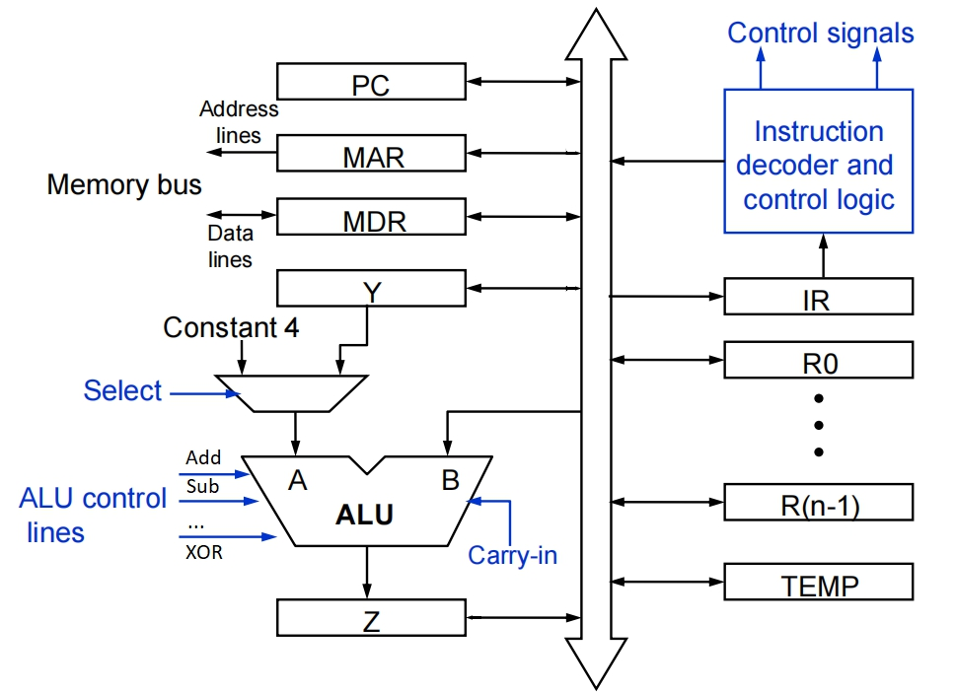
Processor Organization
Textbook Page 413

Slide 7
Executing an Instruction
Transfer a word of data from one processor register to another or to the ALU.
Perform an arithmetic or a logic operation and store the result in a processor register.
Fetch the contents of a given memory location and load them into a processor register.
Store a word of data from a processor register into a given memory location.

Slide 8
Register Transfers
Internal processor
b
us
R
i
in
R
i
R
i
out
Y
in
Y
Constant 4
Select
MUX
A
B
ALU
Z
in
Z
Z
out
Figure 7.2. Input and output gating for the registers in Figure 7.1.

Slide 9
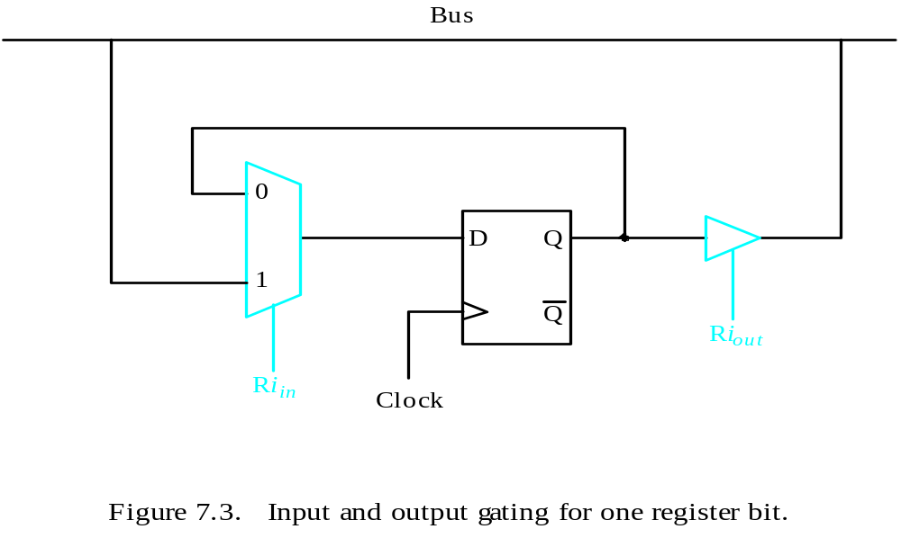
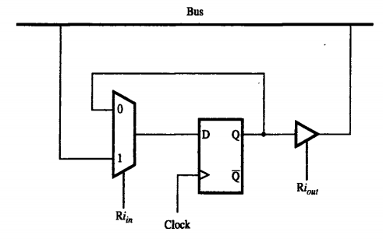
Register Transfers
All operations and data transfers are controlled by the processor clock.
Figure 7.3. Input and output gating for one register bit.

Slide 10
Performing an Arithmetic or Logic Operation
The ALU is a combinational circuit that has no internal storage.
ALU gets the two operands from MUX and bus. The result is temporarily stored in register Z.
What is the sequence of operations to add the contents of register R1 to those of R2 and store the result in R3?
  R1out, Yin
  R2out, SelectY, Add, Zin
  Zout, R3in

Slide 11
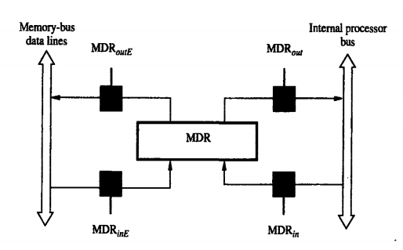
Fetching a Word from Memory
Address into MAR; issue Read operation; data into MDR.
Figure 7.4. Connection and control signals for register MDR.

Slide 12
Fetching a Word from Memory
The response time of each memory access varies (cache miss, memory-mapped I/O,…).
To accommodate this, the processor waits until it receives an indication that the requested operation has been completed (Memory-Function-Completed, MFC).
Move (R1), R2
MAR ← [R1]
Start a Read operation on the memory bus
Wait for the MFC response from the memory
Load MDR from the memory bus
R2 ← [MDR]

Slide 13
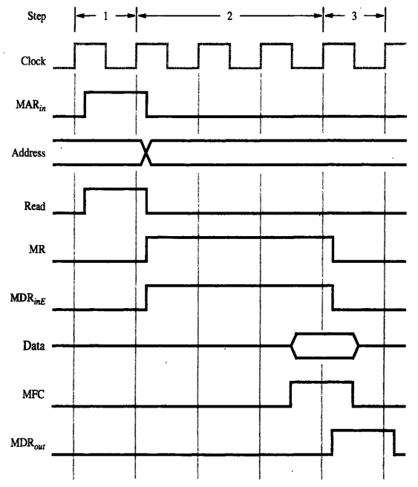
Timing of a Memory Read
Assume MAR is always available on the address lines of the memory bus.
MAR ← [R1]
Start a Read operation on the memory bus
Wait for the MFC response from the memory
Load MDR from the memory bus
R2 ← [MDR]

Slide 14
Execution of a Complete Instruction
Add (R3), R1
Fetch the instruction
Fetch the first operand (the contents of the memory location pointed to by R3)
Perform the addition
Load the result into R1

Slide 15
Architecture
Internal processor
b
us
R
i
in
R
i
R
i
out
Y
in
Y
Constant 4
Select
MUX
A
B
ALU
Z
in
Z
Z
out
Figure 7.2. Input and output gating for the registers in Figure 7.1.

Slide 16
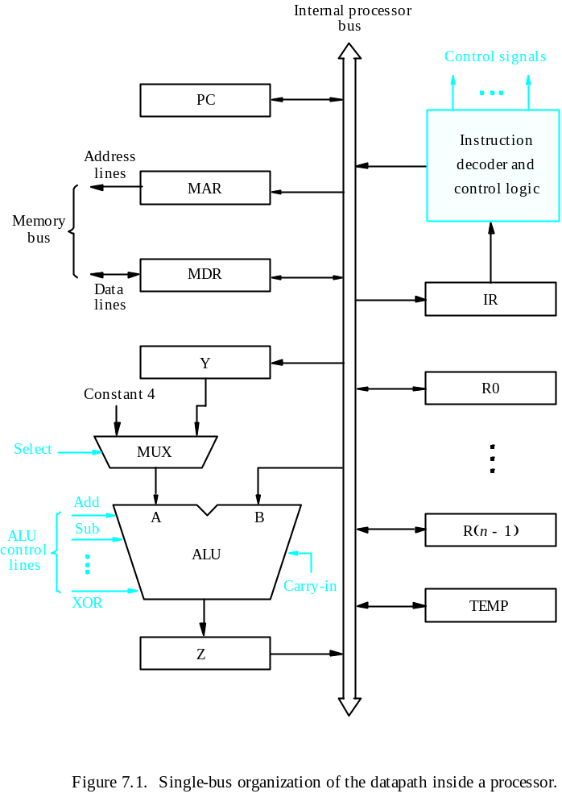
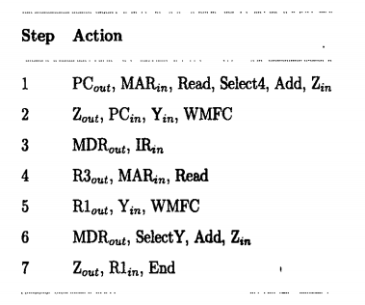
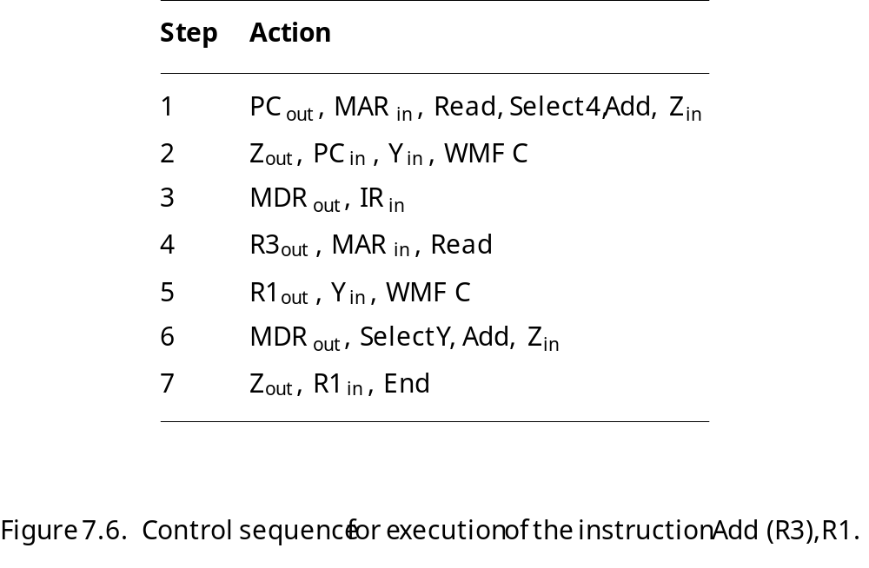
Execution of a Complete Instruction
Add (R3), R1

Slide 17
Execution of Branch Instructions
A branch instruction replaces the contents of PC with the branch target address, which is usually obtained by adding an offset X given in the branch instruction.
The offset X is usually the difference between the branch target address and the address immediately following the branch instruction.
Conditional branch

Slide 18
Execution of Branch Instructions
Step
Action
1
PC
out
,
MAR
in
,
Read,
Select4,
Add,
Z
in
2
Z
out
,
PC
in
,
Y
in
,
WMF
C
3
MDR
out
,
IR
in
4
Offset-field-of-IR
out
,
Add,
Z
in
5
Z
out
,
PC
in
,
End
Figure 7.7. Control sequence for an unconditional branch instruction.

Slide 19
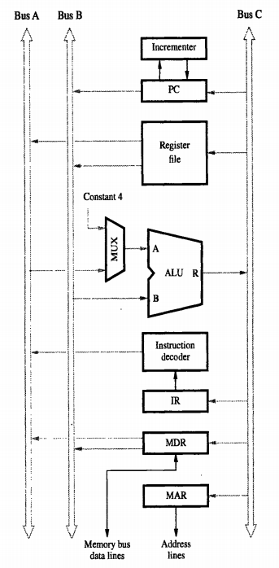
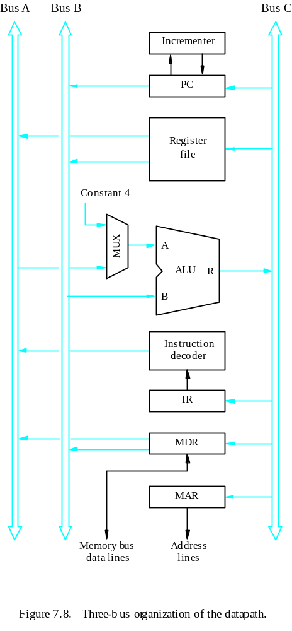
Multiple-Bus Organization

Slide 20
Multiple-Bus Organization
Add R4, R5, R6
Step
Action
1
PC
out
,
R=B,
MAR
in
,
Read,
IncPC
2
WMF
C
3
MDR
outB
,
R=B,
IR
in
4
R4
outA
,
R5
outB
,
SelectA,
Add,
R6
in
,
End
Figure 7.9. Control sequence for the instruction. Add R4,R5,R6,
for the three-bus organization in Figure 7.8.

Slide 21
Quiz
What is the control sequence for execution of the instruction
Add R1, R2
including the instruction fetch phase? (Assume single bus architecture)

Slide 22
Hardwired Control

Slide 23
Overview
To execute instructions, the processor must have some means of generating the control signals needed in the proper sequence.
Two categories: hardwired control and microprogrammed control
Hardwired system can operate at high speed; but with little flexibility.

Slide 24
Control Unit Organization
Clock
CLK
Control step
counter
External
inputs
Decoder/
IR
encoder
Condition
codes
Control signals
Figure 7.10. Control unit organization.

Slide 25
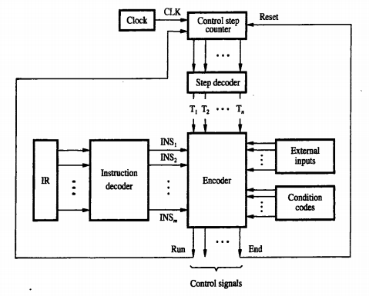
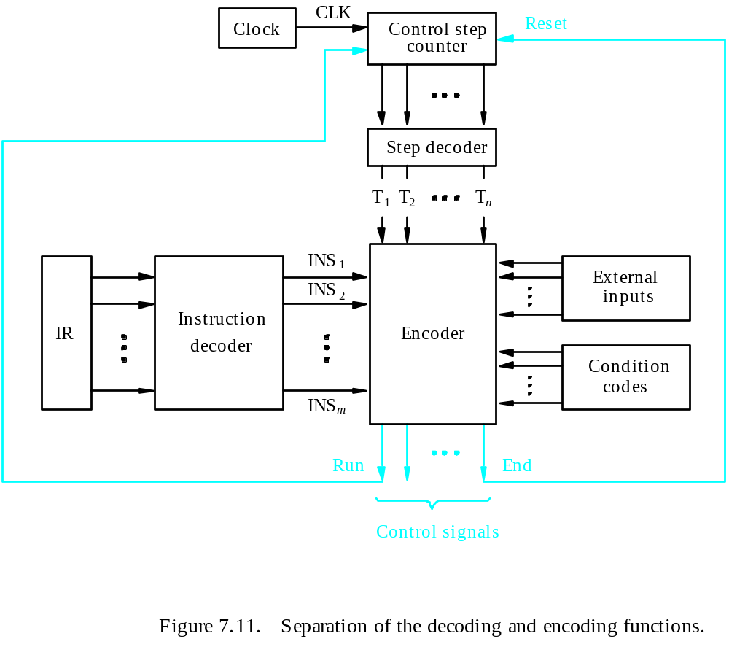
Detailed Block Description

Slide 26
Generating Z_{in}
Z_{in} = T₁ + T₆ • ADD + T₄ • BR + …
Branch
Add
T
4
T
6
T
1
Figure 7.12. Generation of the Z_{in} control signal for the processor in Figure 7.1.

Slide 27
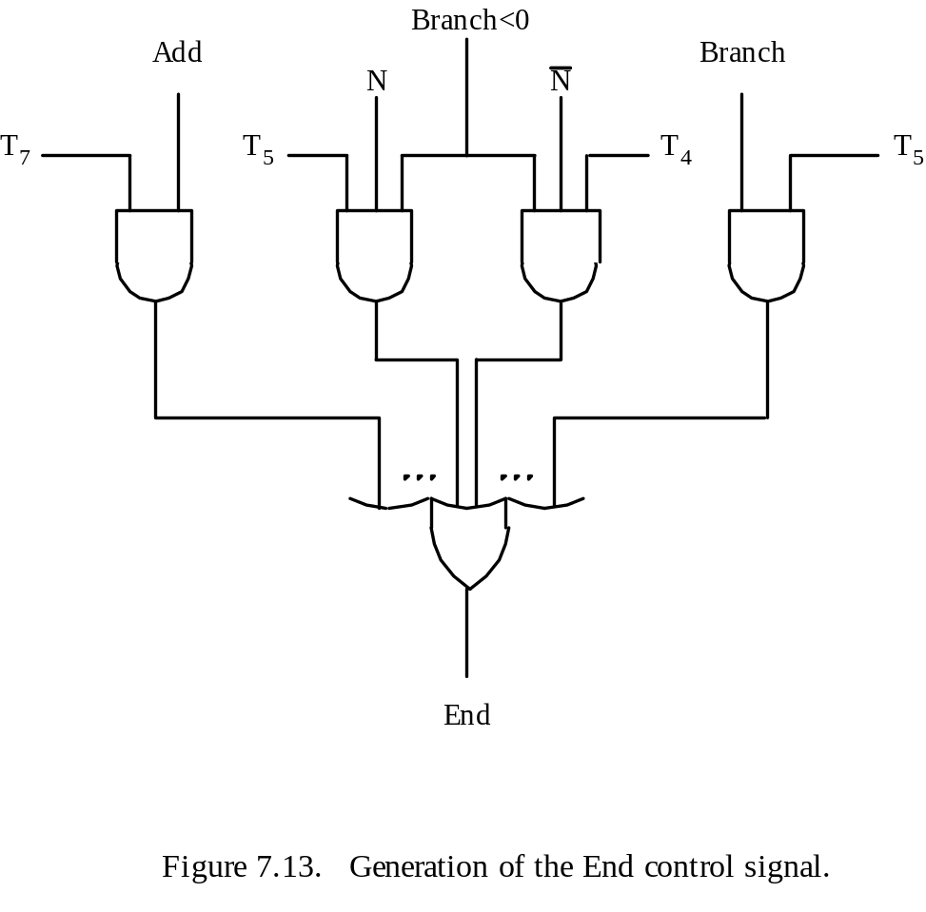
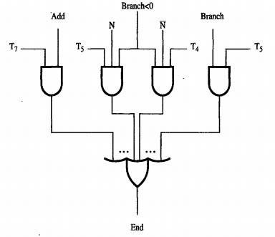
Generating End
End = T₇ • ADD + T₅ • BR + (T₅ • N + T₄ • N) • BRN +…

Slide 28
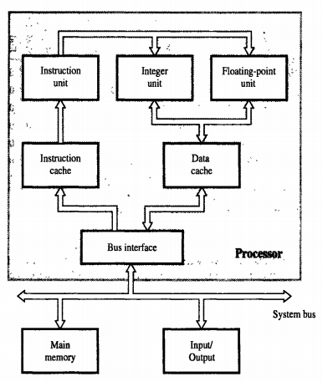
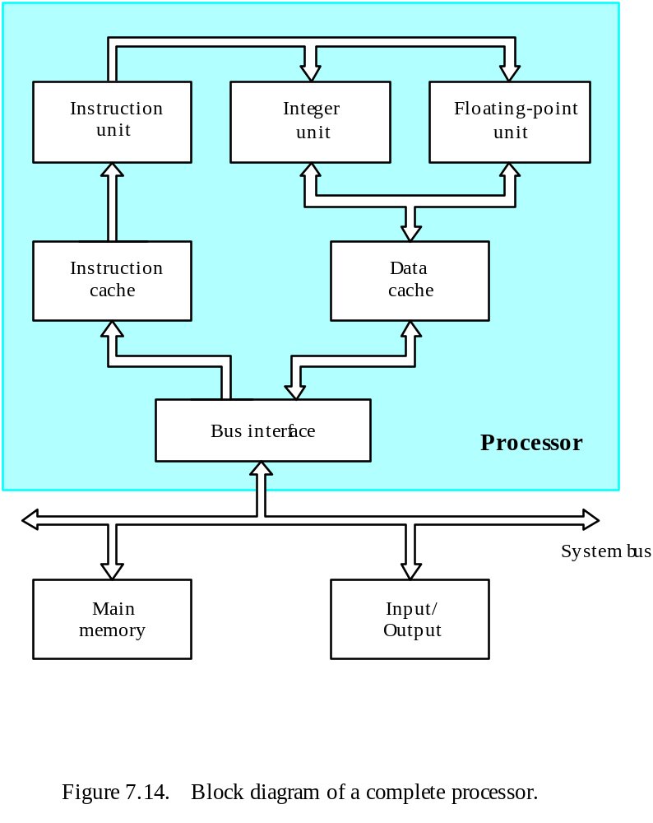
A Complete Processor

Slide 29
Microprogrammed Control

Slide 30
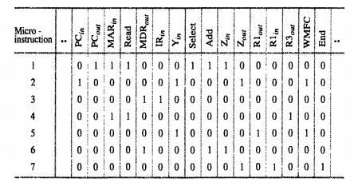
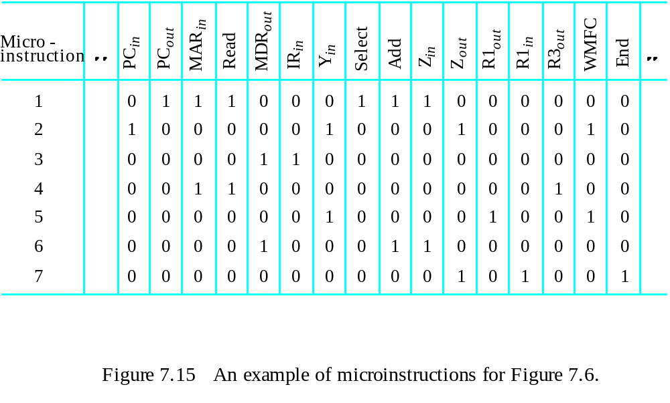
Overview
Control signals are generated by a program similar to machine language programs.
Control Word (CW); microroutine; microinstruction

Slide 31
Overview
ADD (R3),R1

Slide 32
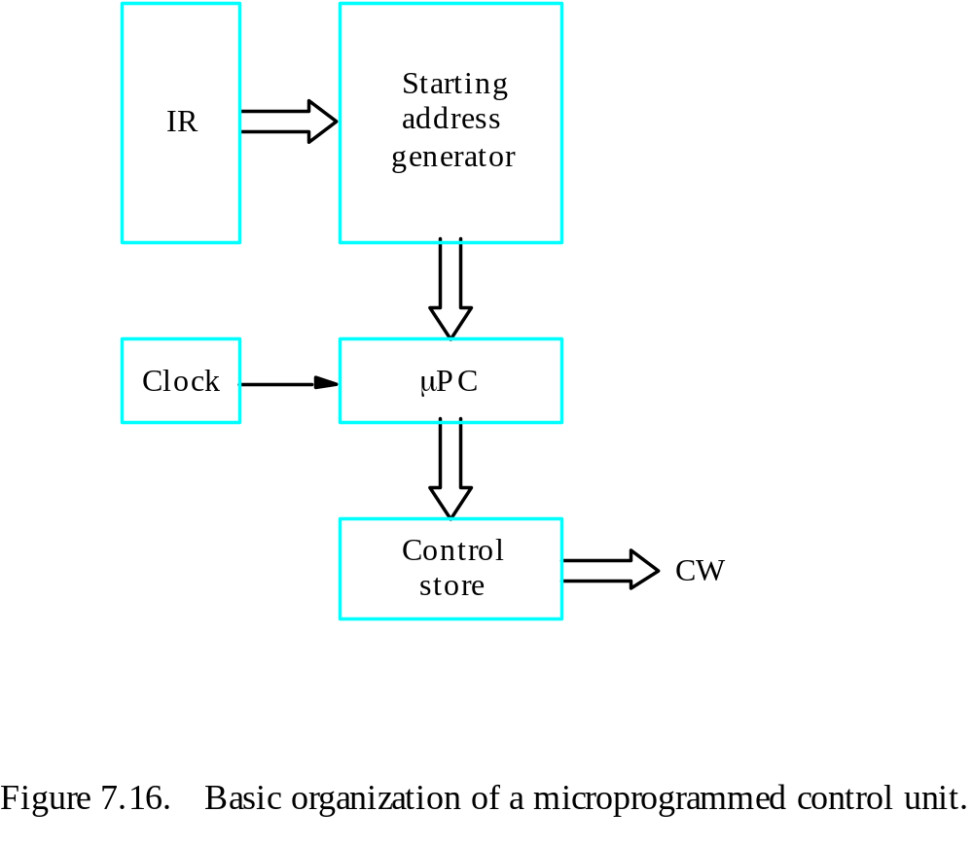
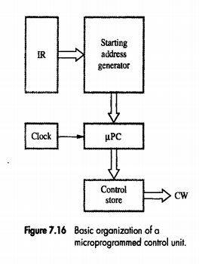
Overview
Control store
One function
cannot be carried
out by this simple
organization.

Slide 33
Overview
The previous organization cannot handle the situation when the control unit is required to check the status of the condition codes or external inputs to choose between alternative courses of action.
Use conditional branch microinstruction.
Address
Microinstruction
0
PC
out
,
MAR
in
,
Read,
Select4,
Add,
Z
in
1
Z
out
,
PC
in
,
Y
in
,
WMF
C
2
MDR
out
,
IR
in
3
Branch
to
starting
address
of
appropriate
microroutine
.
.
.
.
.
.
.
.
.
.
.
.
.
.
.
.
.
.
.
.
.
.
.
.
.
.
.
.
.
.
.
.
.
.
.
.
.
.
.
.
.
.
.
.
.
.
.
.
.
.
.
.
.
.
.
.
.
.
.
.
.
.
.
.
.
.
25
If
N=0,
then
branch
to
microinstruction
0
26
Offset-field-of-IR
out
,
SelectY,
Add,
Z
in
27
Z
out
,
PC
in
,
End
Figure 7.17. Microroutine for the instruction Branch<0.

Slide 34
Overview
External
inputs
Starting and
Condition
IR
branch address
codes
generator
Clock
μ
P
C
Control
CW
store
Figure 7.18. Organization of the control unit to allow
conditional branching in the microprogram.

Slide 35
Microinstructions
A straightforward way to structure microinstructions is to assign one bit position to each control signal.
However, this is very inefficient.
The length can be reduced: most signals are not needed simultaneously, and many signals are mutually exclusive.
All mutually exclusive signals are placed in the same group in binary coding.

Slide 36
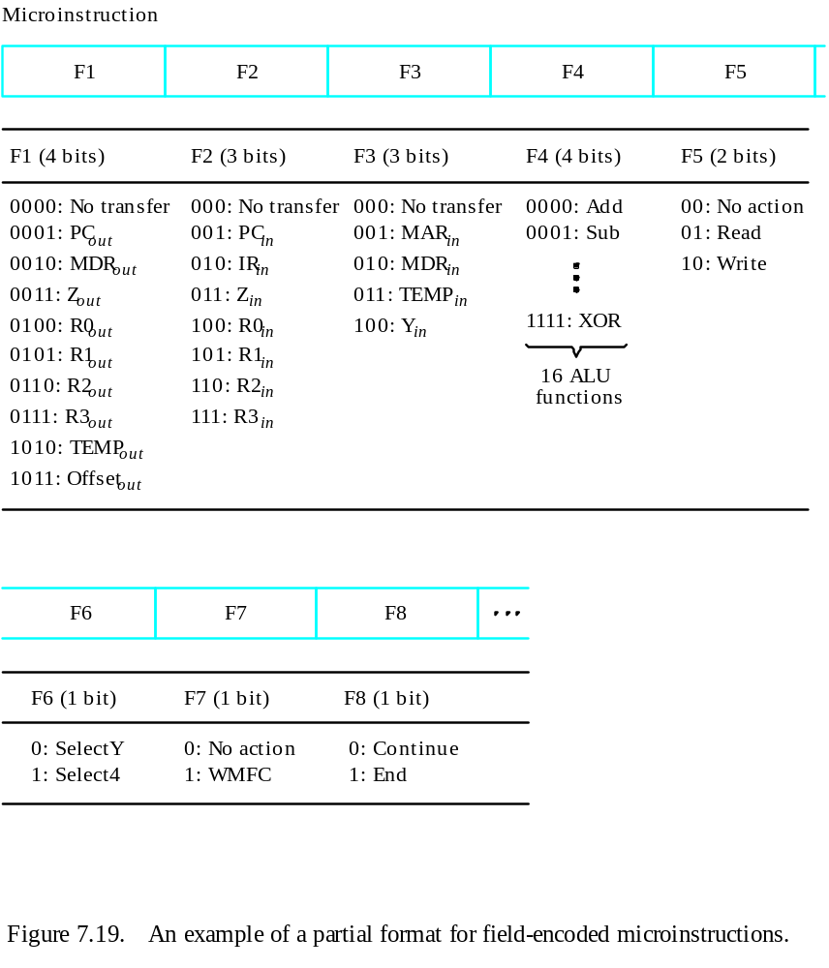
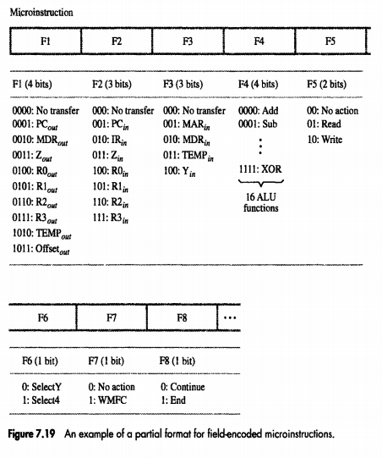
Partial Format for the Microinstructions
What is the price paid for this scheme?

Slide 37
Further Improvement
Enumerate the patterns of required signals in all possible microinstructions. Each meaningful combination of active control signals can then be assigned a distinct code.
Vertical organization
Horizontal organization

Slide 38
Microprogram Sequencing
If all microprograms require only straightforward sequential execution of microinstructions except for branches, letting a μPC governs the sequencing would be efficient.
However, two disadvantages:
Having a separate microroutine for each machine instruction results in a large total number of microinstructions and a large control store.
Longer execution time because it takes more time to carry out the required branches.
Example: Add src, Rdst
Four addressing modes: register, autoincrement, autodecrement, and indexed (with indirect forms).

Slide 39
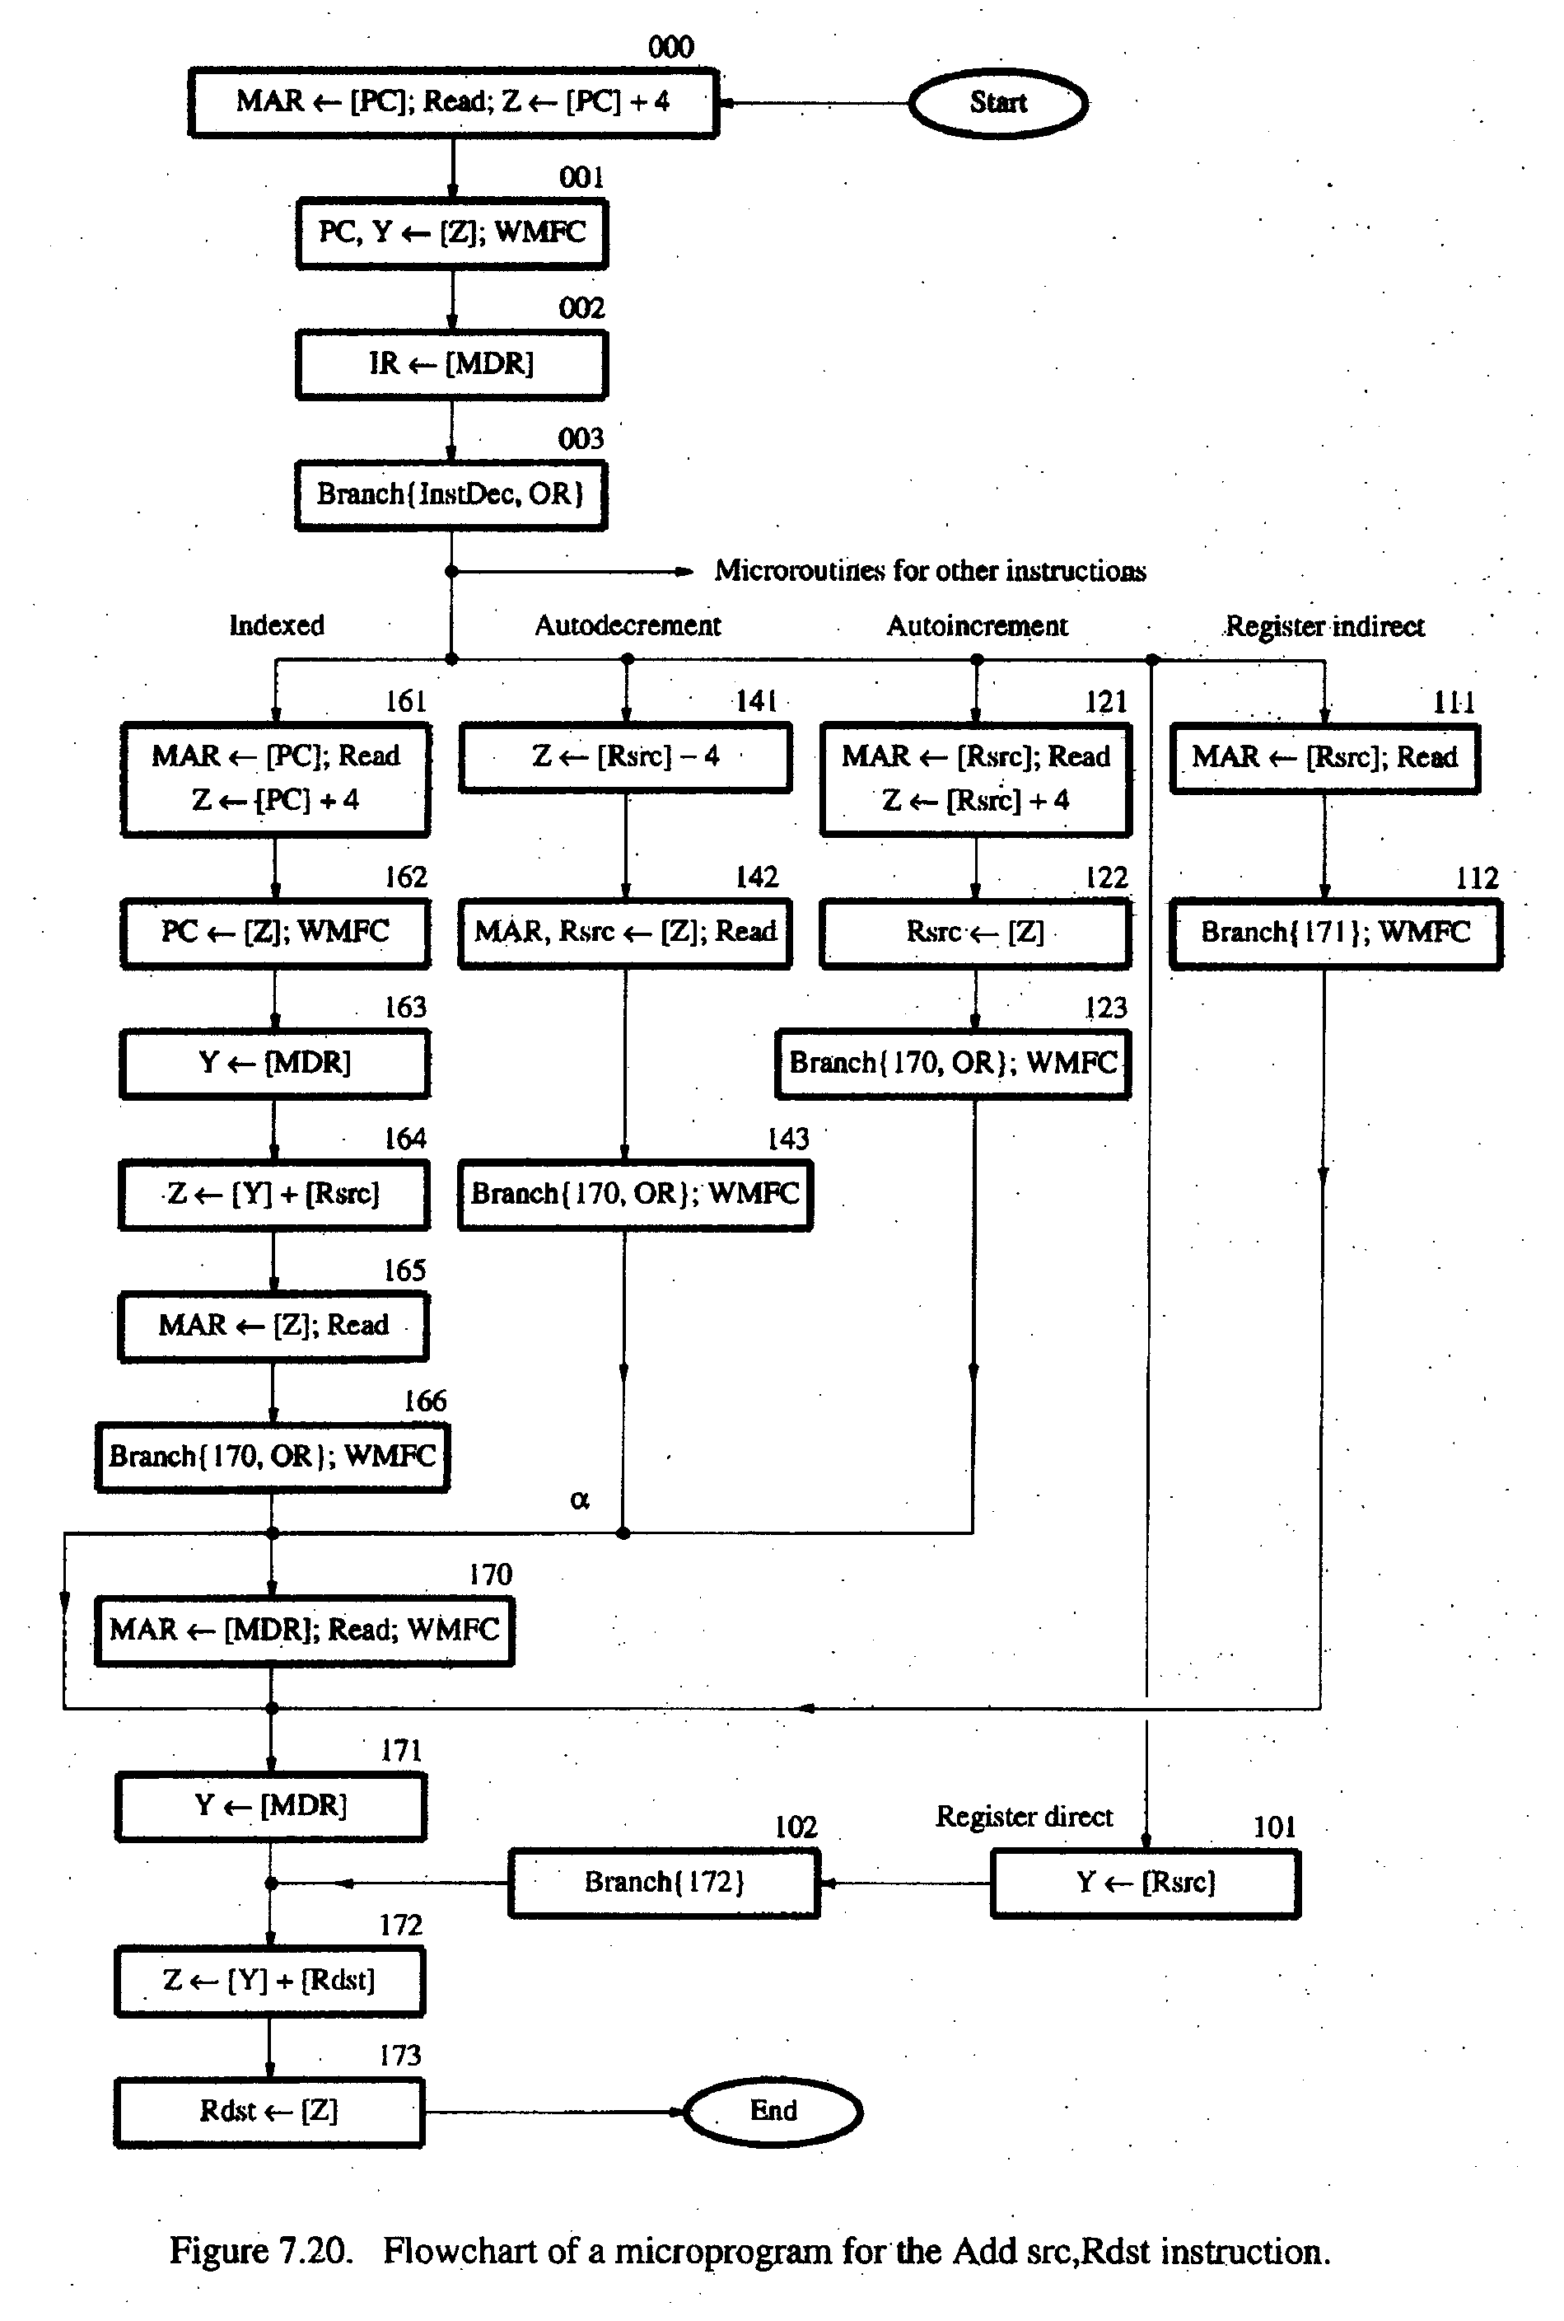
- Bit-ORing
- Wide-Branch Addressing
- WMFC

Slide 40
Mode
Contents of IR
OP code
0
1
0
Rsrc
Rdst
11
10
8
7
4
3
0
Address
Microinstruction
(octal)
000
PC
, MAR
, Read, Select
, Add, Z
out
in
4
in
001
Z
out
, PC
in
, Y
in
, WMFC
002
MDR
out
, IR
in
003
μ
Branch {
μ
PC
←
101 (from Instruction decoder);
μ
PC
5,4
←
[IR
10,9
];
μ
PC
3
←
[IR
10
]
⋅
[IR
9
]
⋅
[IR
8
]}
121
Rsrc
, MAR
, Read, Select4, Add, Z
out
in
in
122
Z
out
, Rsrc
in
123
μ
Branch {
μ
PC
←
170;
μ
PC
0
←
[IR
8
]}, WMFC
170
MDR
out
, MAR
in
, Read, WMFC
171
MDR
out
, Y
in
172
Rdst
out
, SelectY
, Add, Z
in
173
Z
out
, Rdst
in
, End
Figure 7.21.
Microinstruction for Add (Rsrc)+,Rdst.
Note:
Microinstruction at location 170 is not executed for this addressing mode.

Slide 41
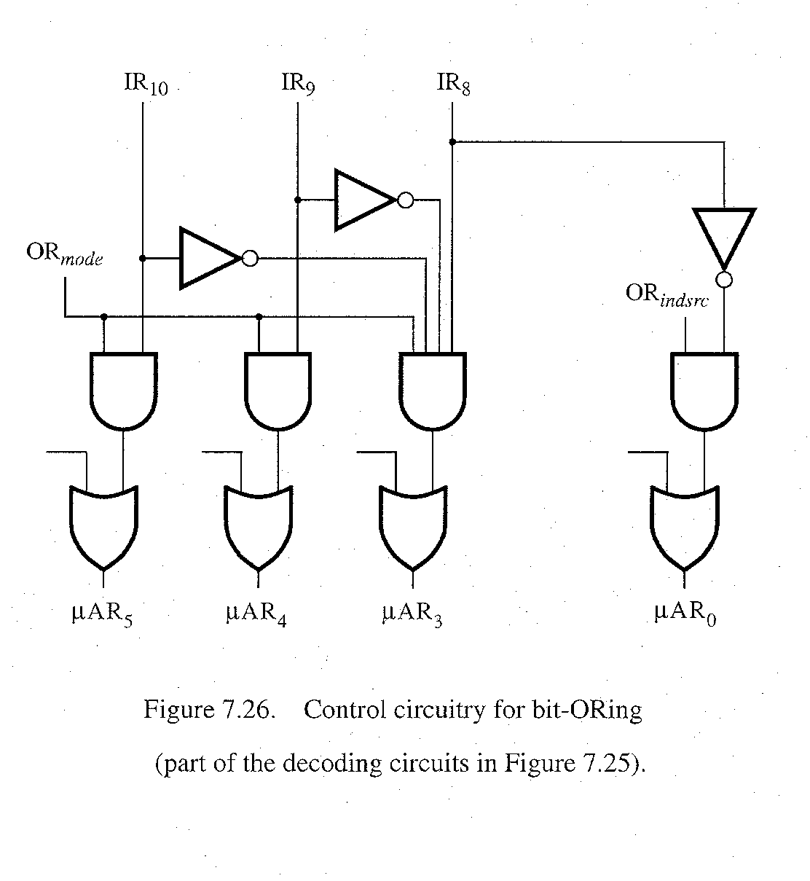
bit-ORing

